Slide 1

Introduction to Java
Your success is our success
Funny Gorilla 诙猩猩
Notes:
Notes for title slide

Slide 2
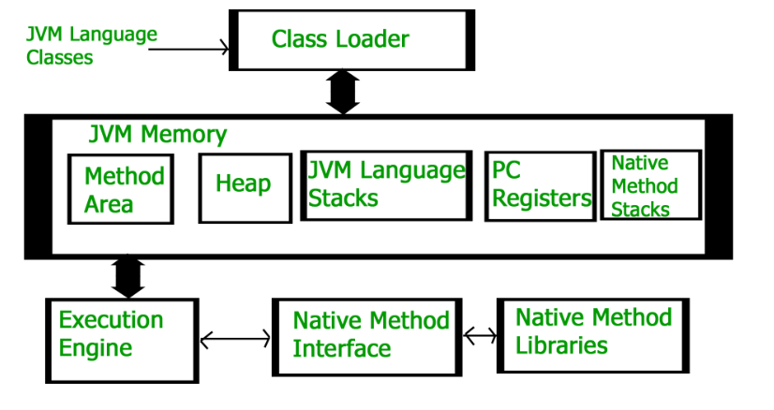
Java Architecture

Slide 3
Java Code execution

Slide 4
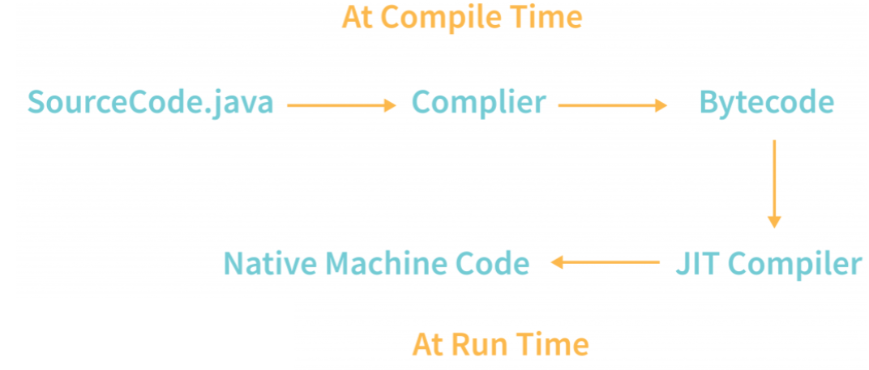

Slide 5
OOP Concepts
Object oriented programming (OOP)
Encapsulation
Inheritance
Composition
Polymorphism

Slide 6
Object Oriented
Student - Class
Object N
attributes
Object 1
Behaviours
APIs

Slide 7
Encapsulation
Object
Method A
Variable
Method B
Variable
Method C
Notes:
the variables of a class are always hidden from other classes.
It can only be accessed using the methods of their current class.

Slide 8
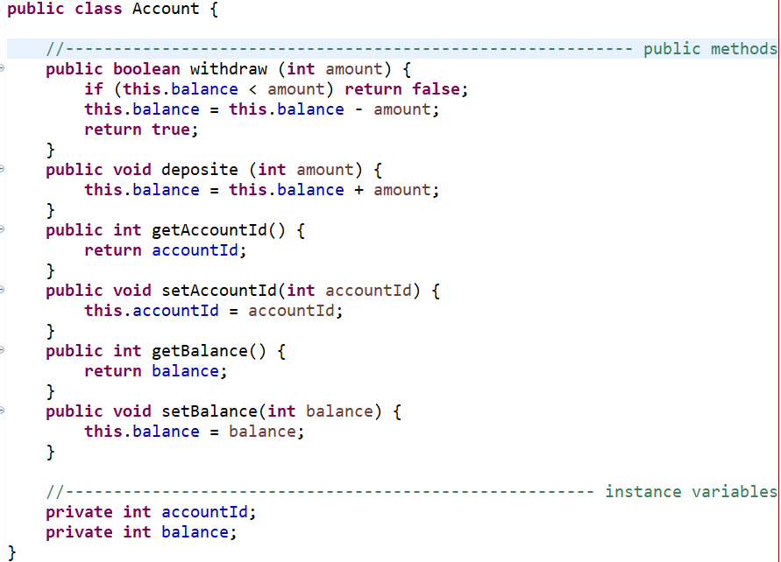
Sample Java

Slide 9
inheritance
Interface
extends
Interface
implements
implements
Abstract Class
extends
extends
Class
Class
Class
create
extends
Object
Class

Slide 10
Sample inheritance
Person
implements
implements
Student
Lecturer
extends
extends
extends
Mechanical majored
Finance majored
CS majored
CS Lecturer
Finance Lecturer
create
Object

Slide 11
Composition
Class
APIs
Behaviours
Object
attribute
attribute
attribute
Object
Object
Object
Notes:
Inheritance is one of the Basic Concepts of OOPs in which one object acquires the properties and behaviors of the parent object. It’s creating a parent-child relationship between two classes. It offers robust and natural mechanism for organizing and structure of any software.

Slide 12
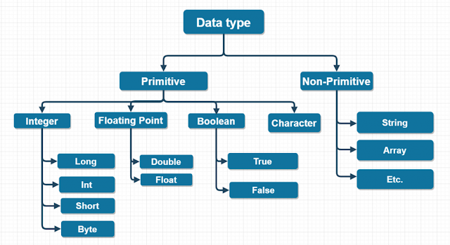
Data Type

Slide 13
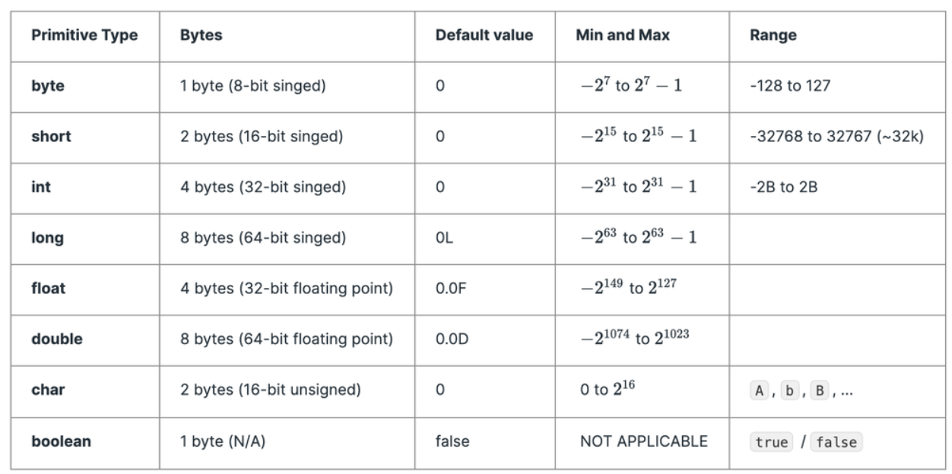
Java Data Types

Slide 14
Method

Slide 15
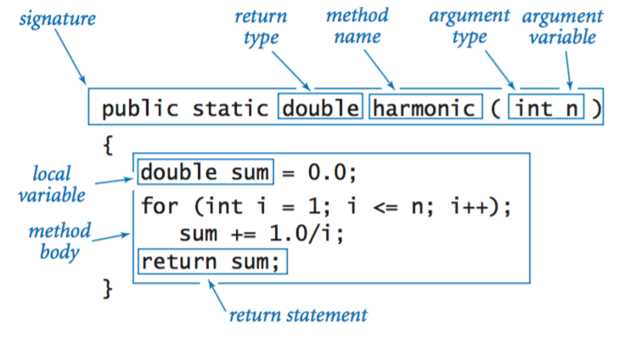
Static Method – Class Level

Slide 16
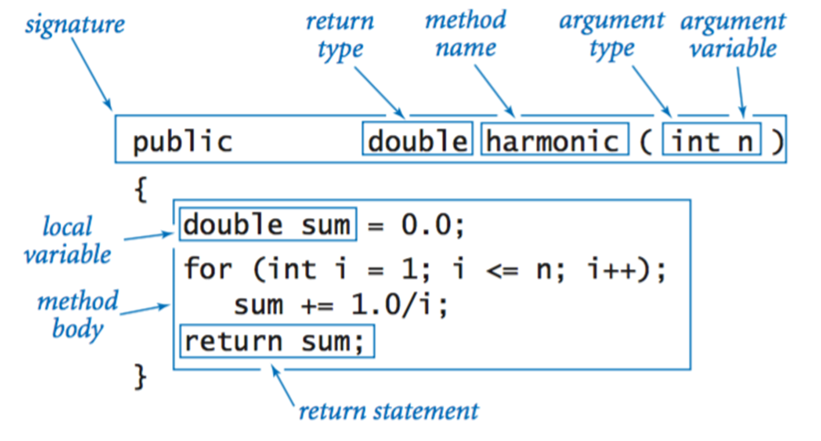
Instance Method

Slide 17
Constructor

Slide 19
Package
Organize java classes
Void naming conflict

Slide 20
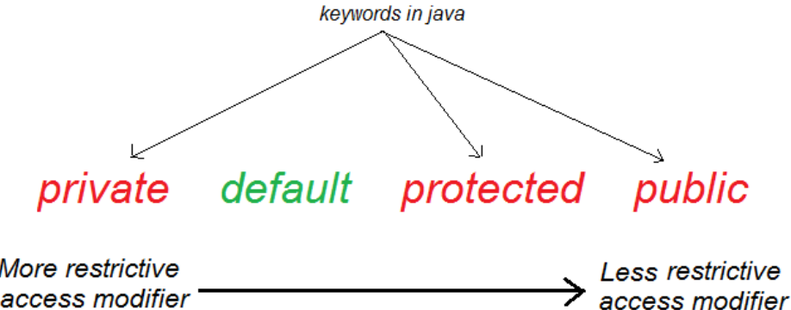
Java Access

Slide 21
Demo access level

Slide 22
Reference
https://www.callicoder.com/java-arraylist/

Slide 23

Your success is our success
Contact
Mail: info@funnygorilla.com.au
Linkedin: https://mt.linkedin.com/in/songqing-gu-2ba9034b/de
Web Chat: FunnyGorilla
Phone: 0420891343

